Slide 1

GREEDY GAYCE - 20146857조호영 -

Slide 2
Concept KeyWord :Pattern,Run
Table of Scenes
* Main
* Select Chapter(6 Chapters)
* Ground Exploding Many Bombs ( play scene)
* Scene displayed when stage end.
* Final Scene

Slide 3
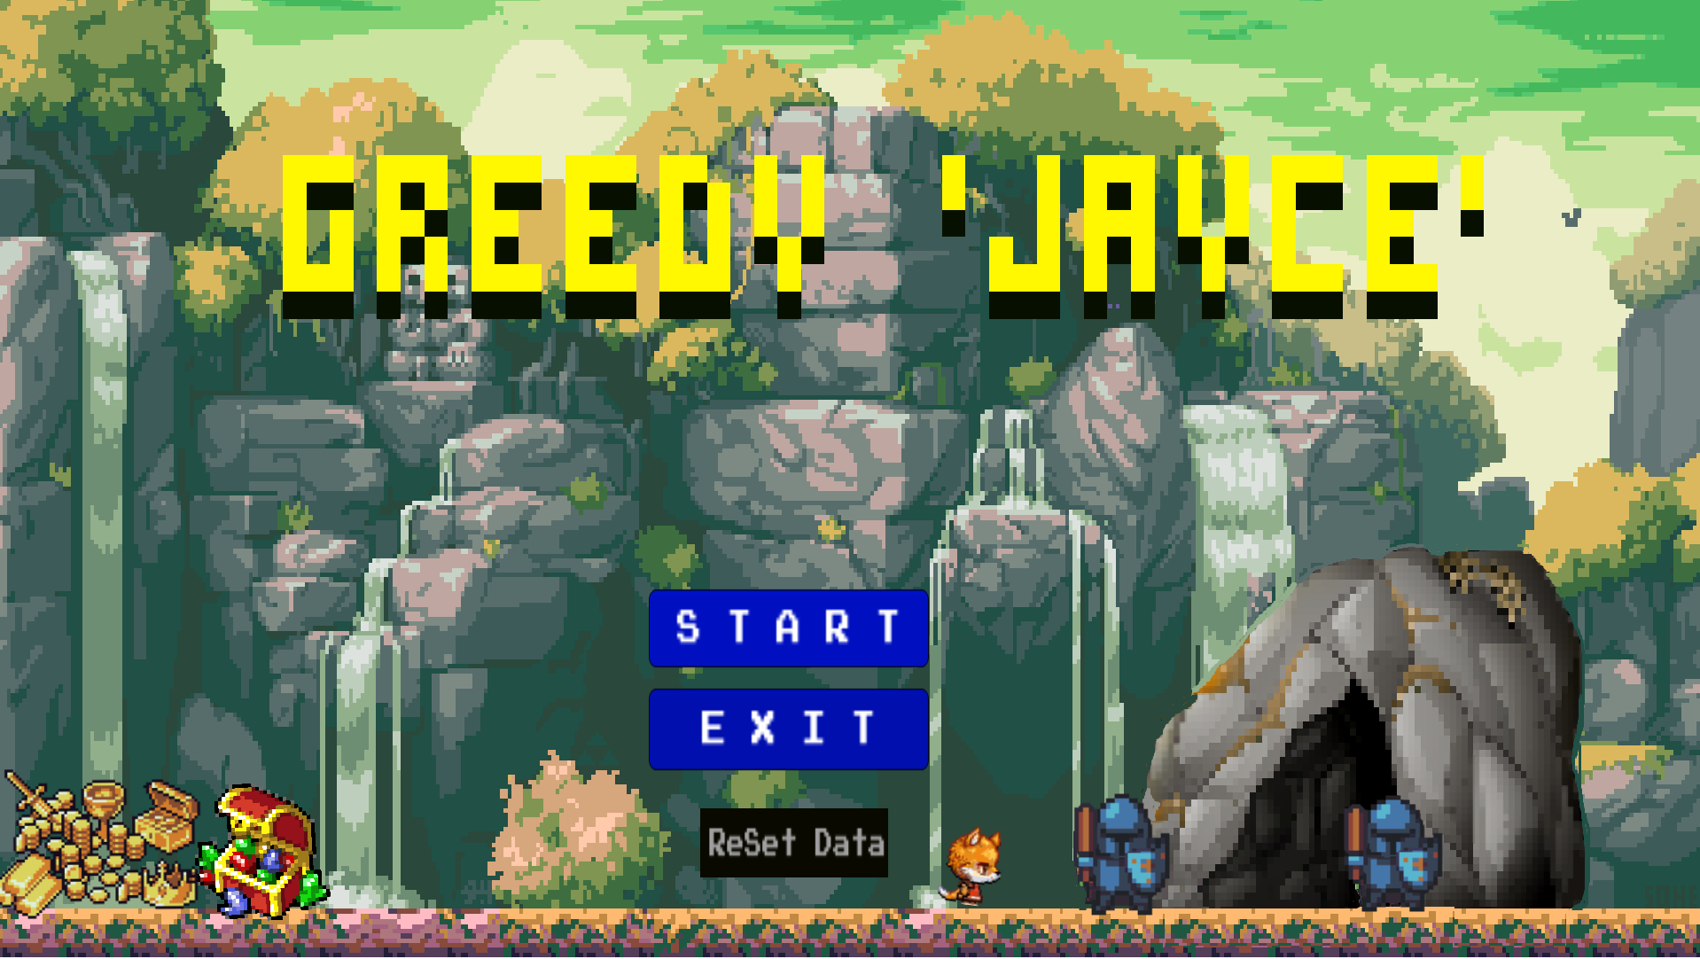
Main Scene
Touch Pad
Player
Wall
Ground
exploding bombs

Slide 4
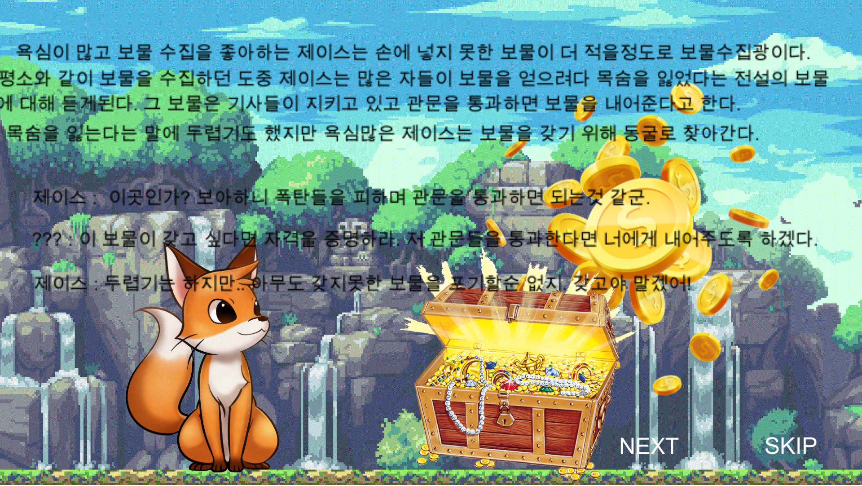
Story Scene
Touch Pad
Player
Wall
Ground
exploding bombs

Slide 5
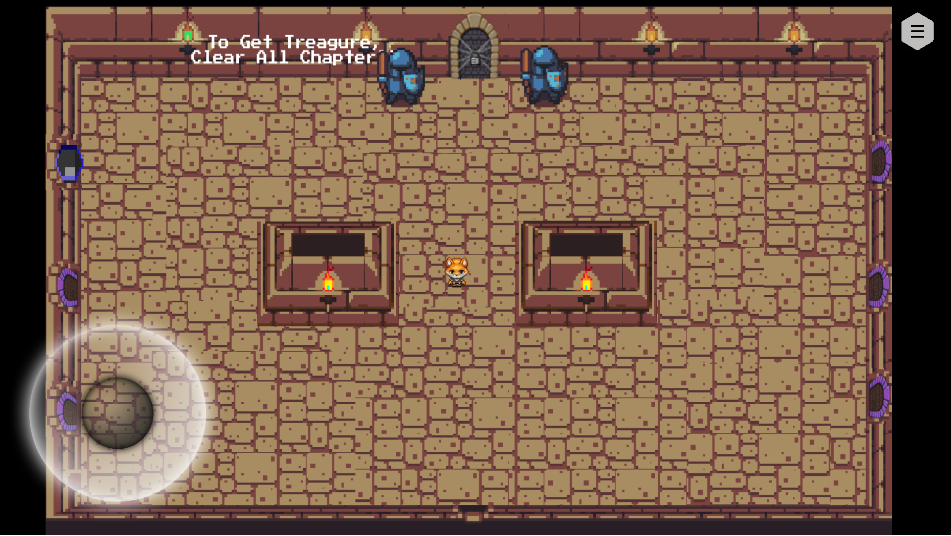
Chapter Scene
Touch Pad
Player
Wall
Ground
exploding bombs

Slide 6
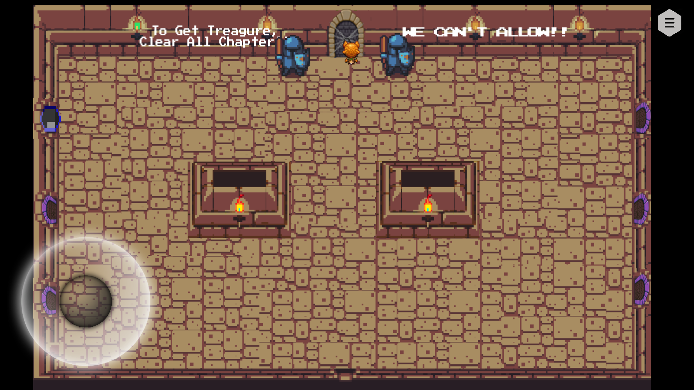
Get Treasure
Touch Pad
Player
Wall
Ground
exploding bombs

Slide 7
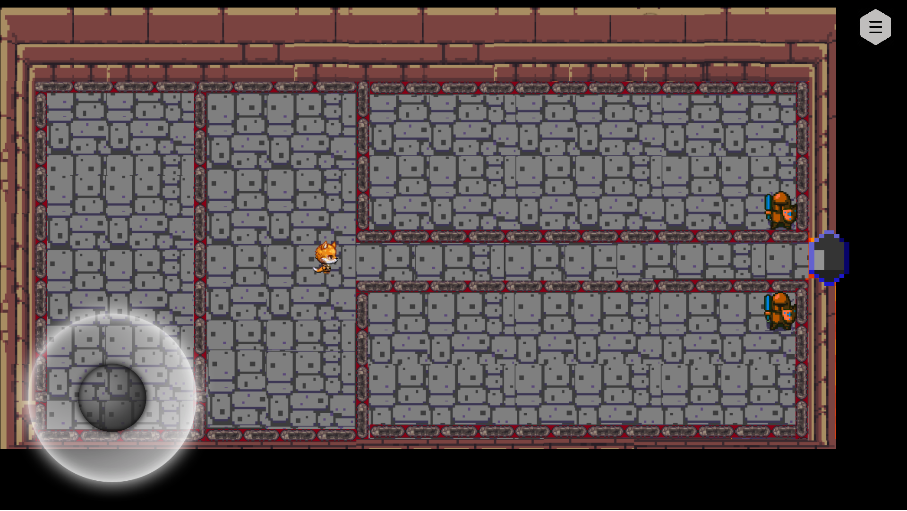
Chapter 1
Touch Pad
Player
Wall
Ground
exploding bombs

Slide 8
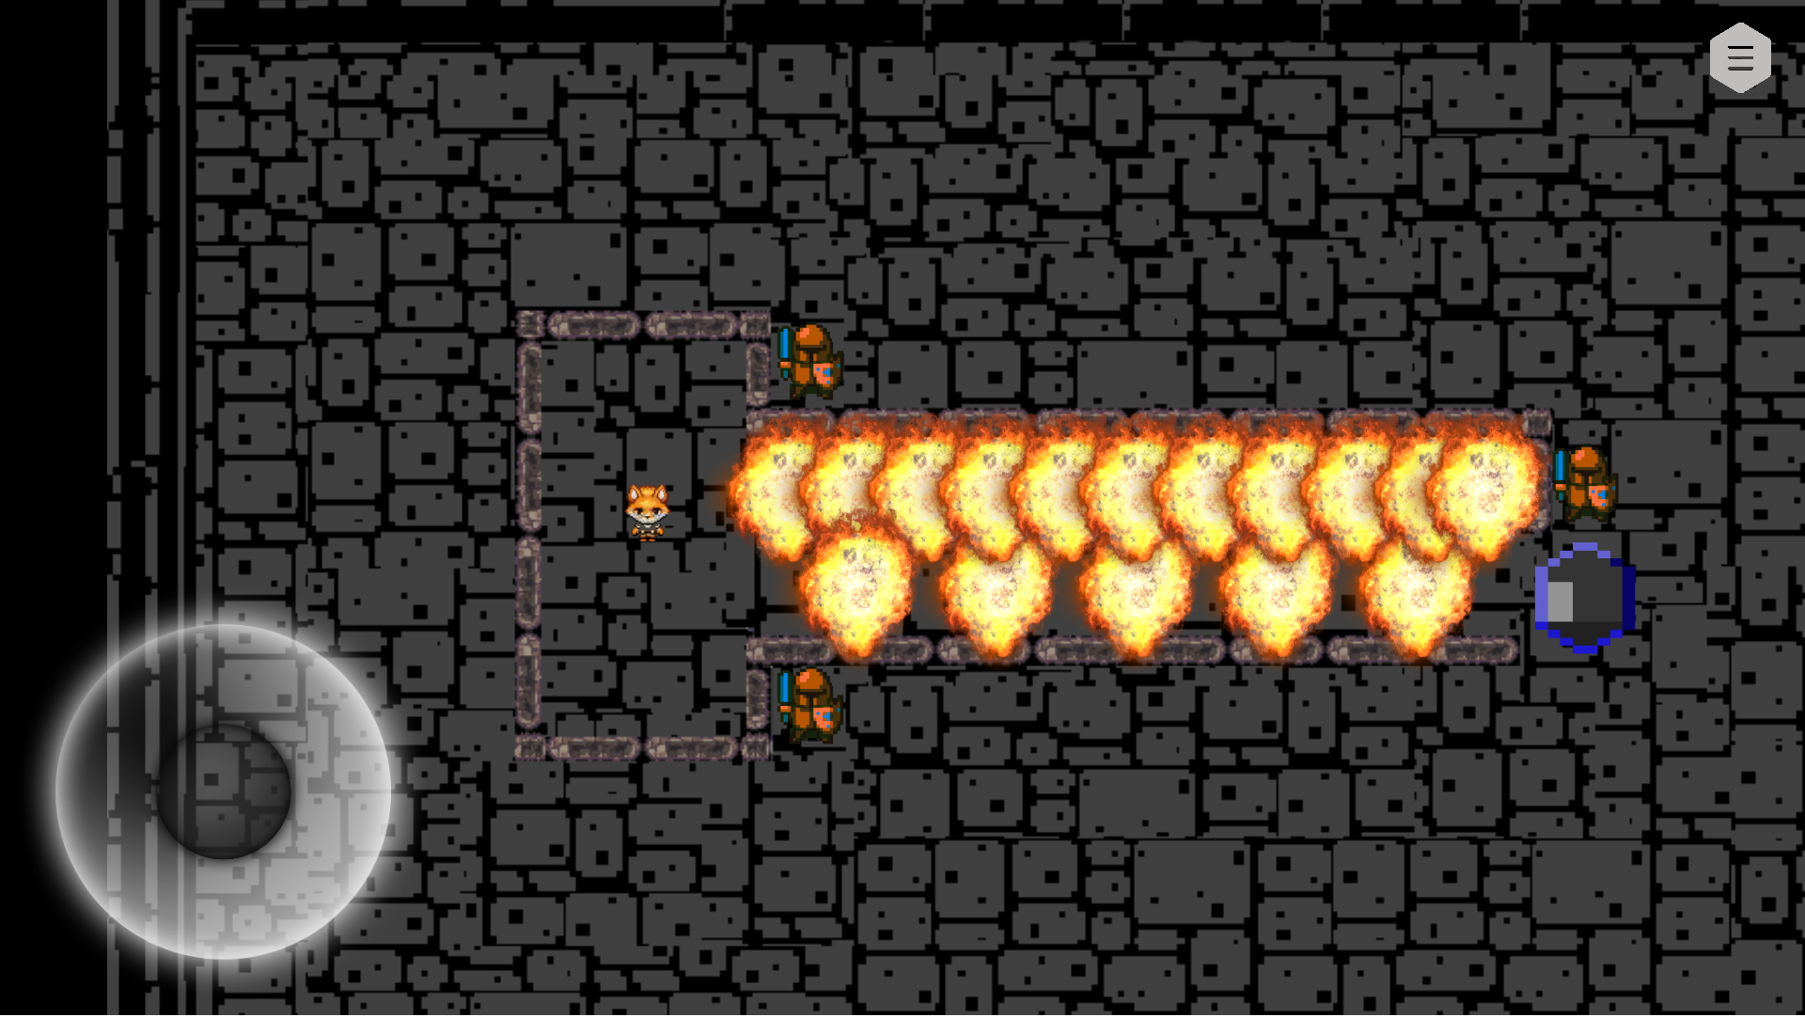
Chapter 2
Touch Pad
Player
Wall
Ground
exploding bombs

Slide 9
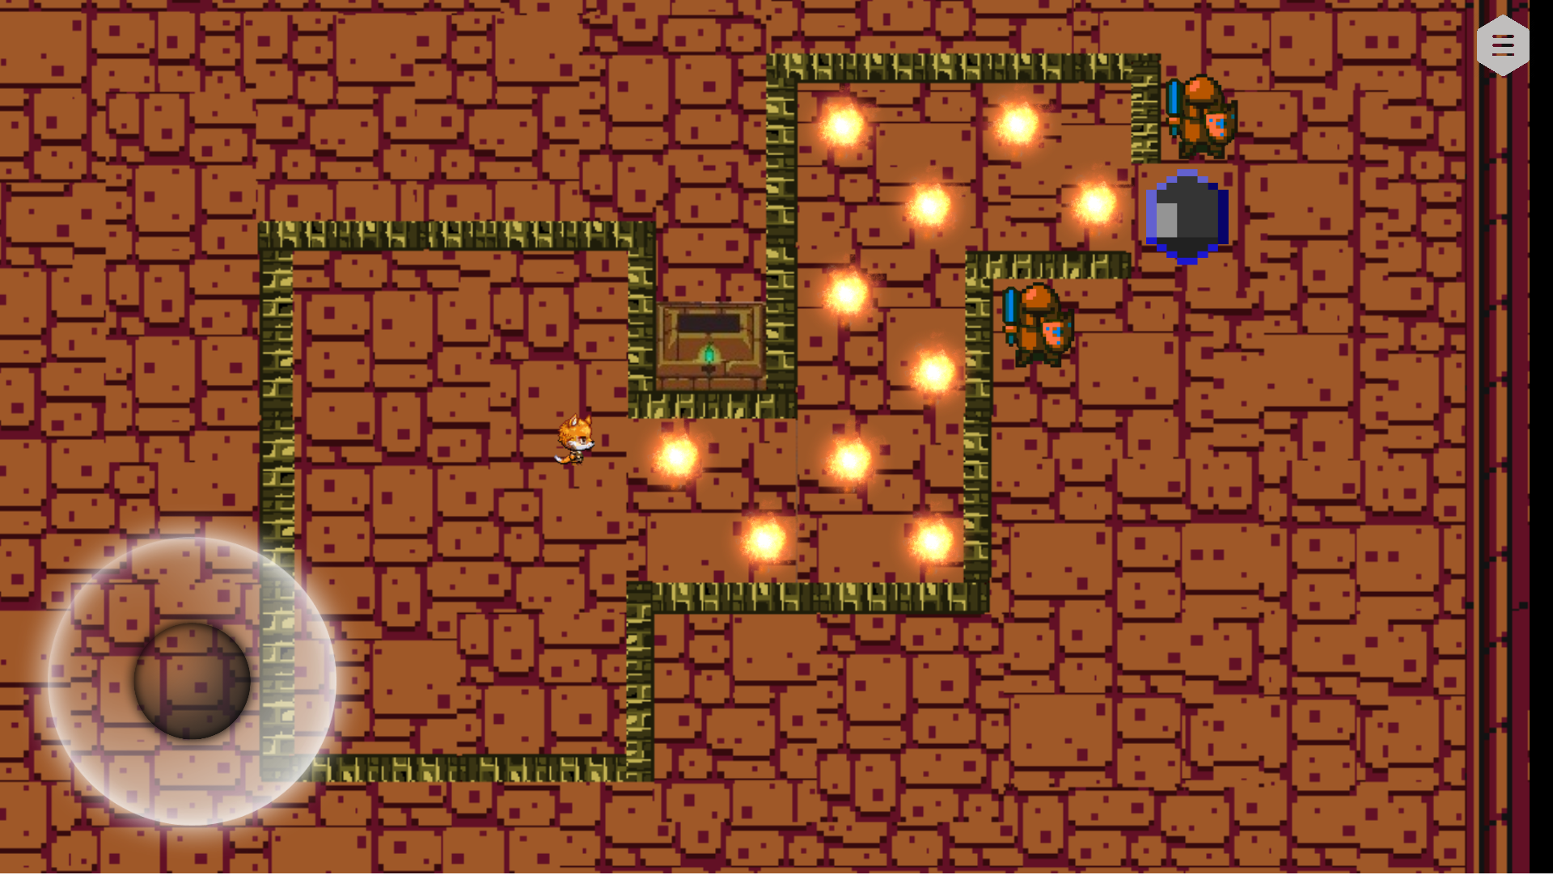
Chapter 3
Touch Pad
Player
Wall
Ground
exploding bombs

Slide 10
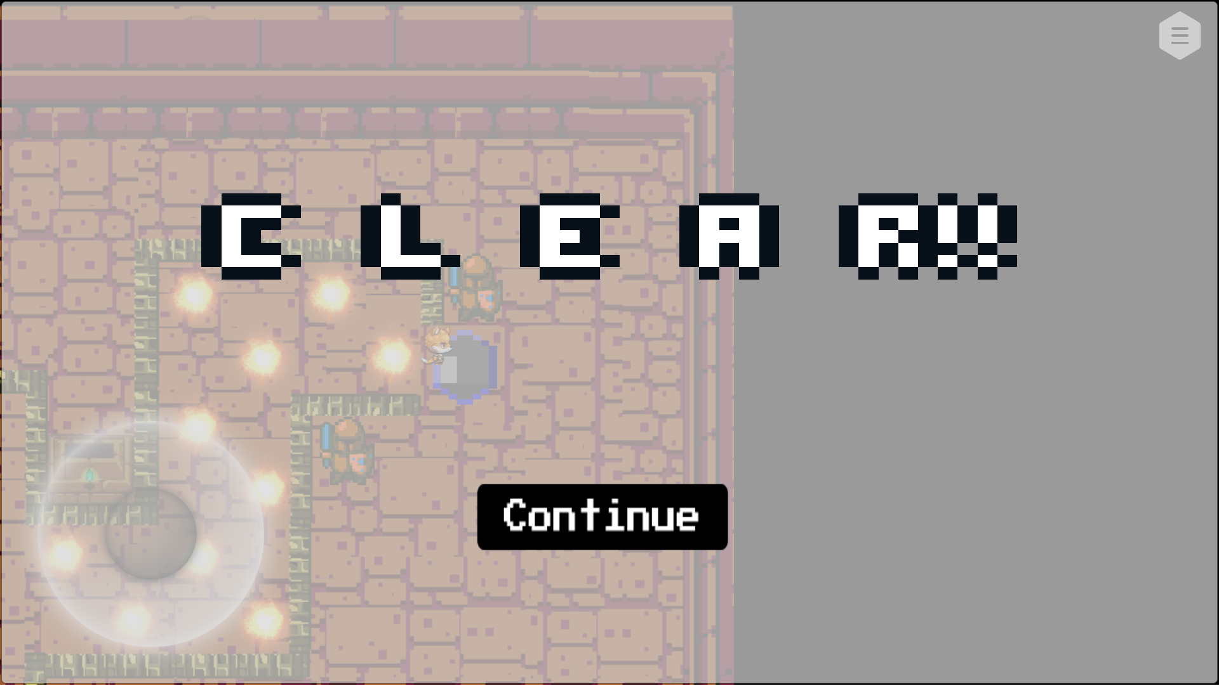
When Clear
Touch Pad
Player
Wall
Ground
exploding bombs

Slide 11

When Clear
Touch Pad
Player
Wall
Ground
exploding bombs

Slide 12
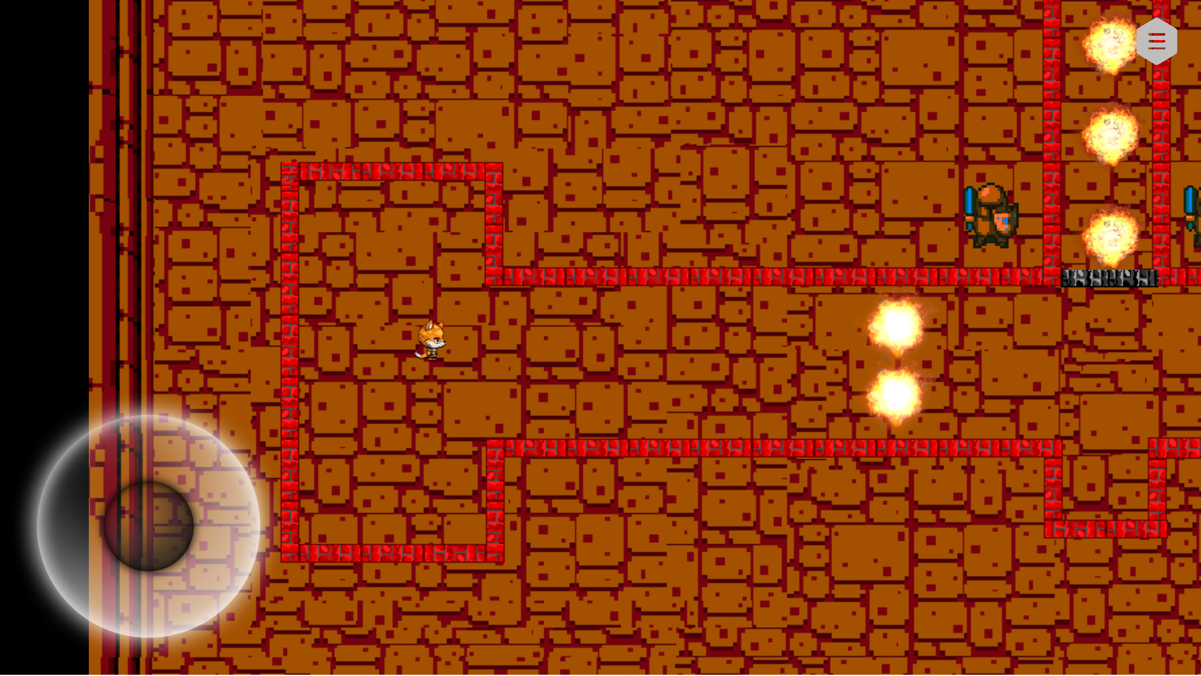
Chapter 4
Touch Pad
Player
Wall
Ground
exploding bombs

Slide 13
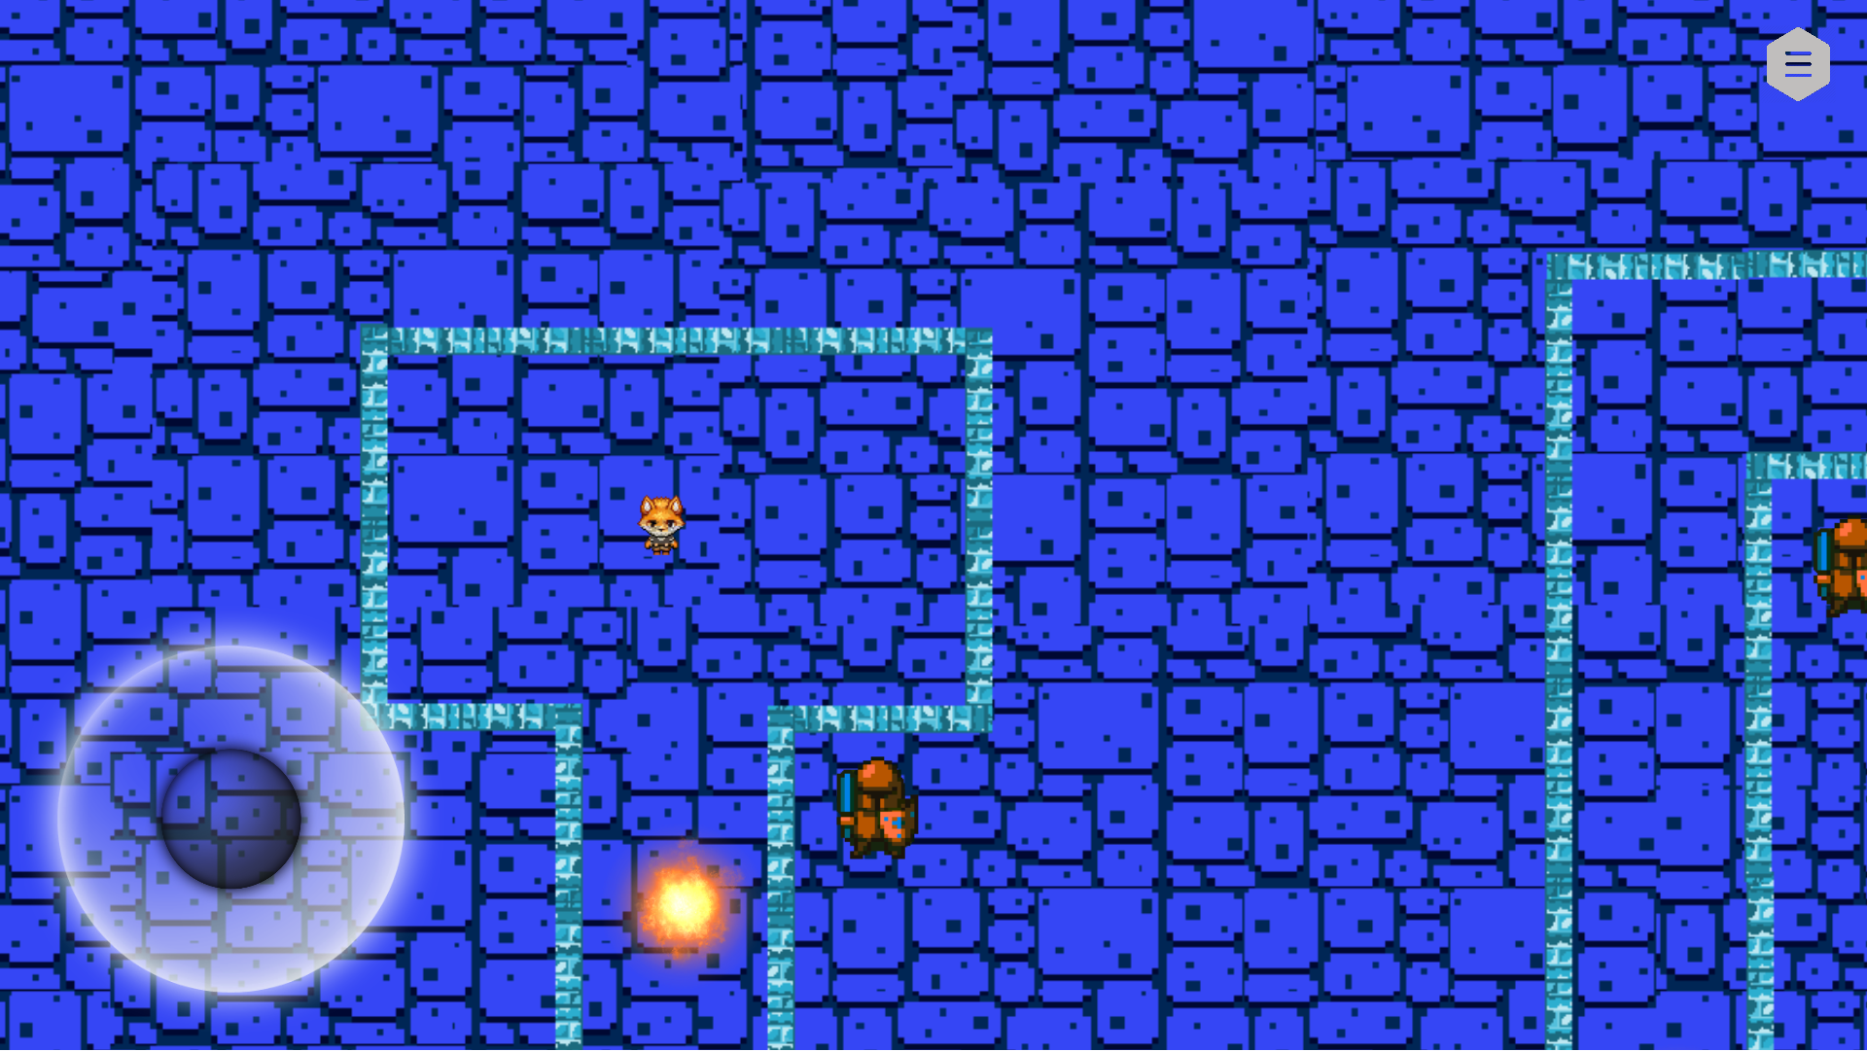
Chapter 5
Touch Pad
Player
Wall
Ground
exploding bombs

Slide 14
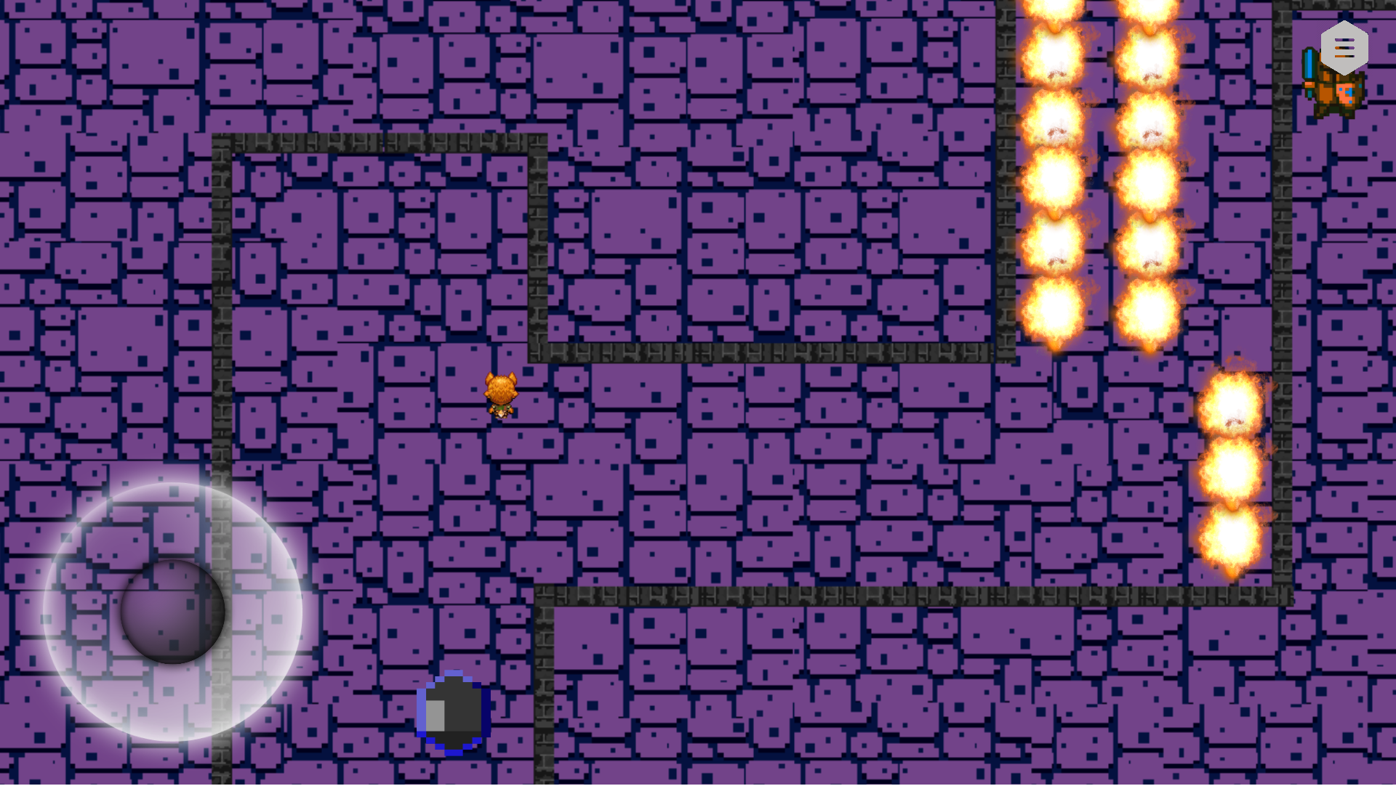
Chapter 6
Touch Pad
Player
Wall
Ground
exploding bombs

Slide 15
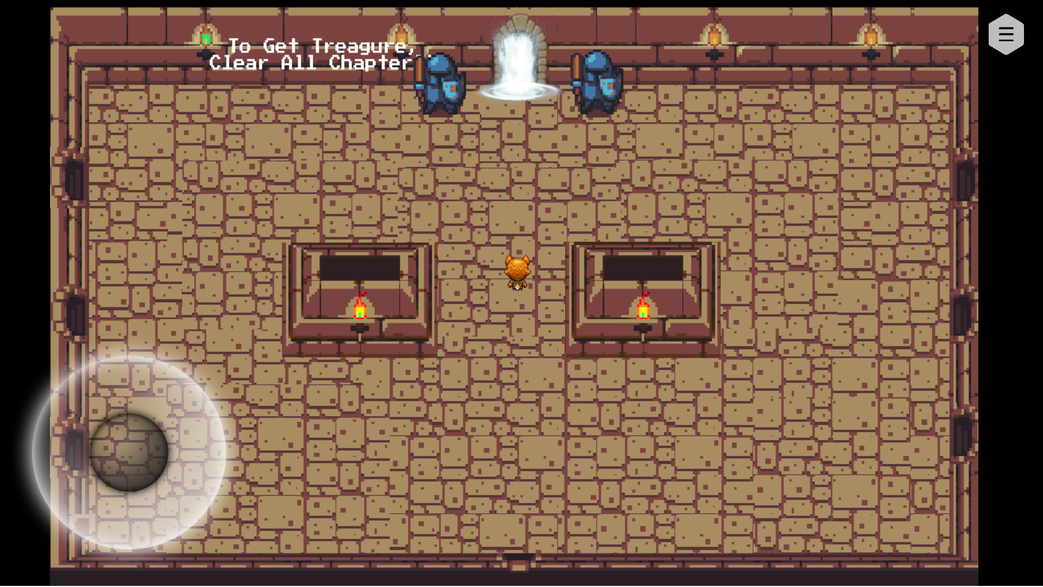
When Clear All Chapters
Touch Pad
Player
Wall
Ground
exploding bombs

Slide 16

Ending Scene
Touch Pad
Player
Wall
Ground
exploding bombs

Slide 17

Thank you :)

